Slide 1
Dynamics of Multirotors
Speaker: Teng-Hu Cheng

Slide 2
Outlines
Rotation Matrix and Quaternion (continued)
Hardware system of UAVs
Preliminaries
Dynamics
PD controller for UAVs

Slide 3
Outlines
Rotation Matrix and Quaternion (continued)
Hardware system of UAVs
Preliminaries
Dynamics
PD controller for UAVs

Slide 4
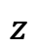

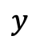
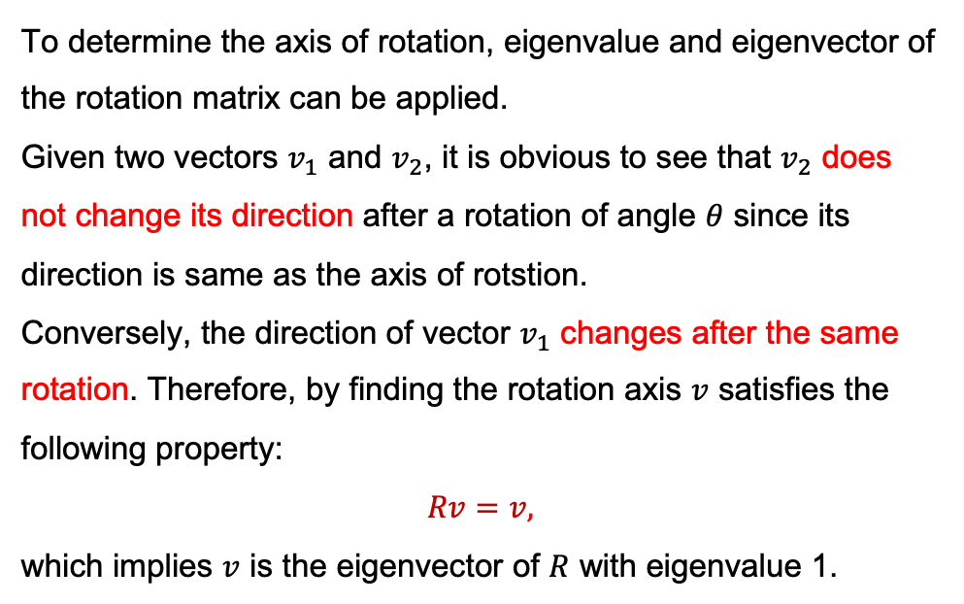
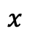

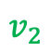
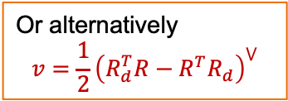
Axis of Rotation given a Rotation Matrix
To determine the axis of rotation, eigenvalue and eigenvector of the rotation matrix can be applied.
Given two vectors $v_{1}$ and $v_{2}$, it is obvious to see that $v_{2}$ does not change its direction after a rotation of angle $θ$ since its direction is same as the axis of rotstion.
Conversely, the direction of vector $v_{1}$ changes after the same rotation. Therefore, by finding the rotation axis $v$ satisfies the following property:
$$Rv=v,$$
which implies $v$ is the eigenvector of $R$ with eigenvalue 1.
$$θ$$
$$z$$
$$v_{2}$$
$$x$$
$$v_{1}$$
$$y$$
Or alternatively
$$v=\frac{1}{2}{\left(R_{d}^{T}R−R^{T}R_{d}\right)}^{⋁}$$

Slide 5
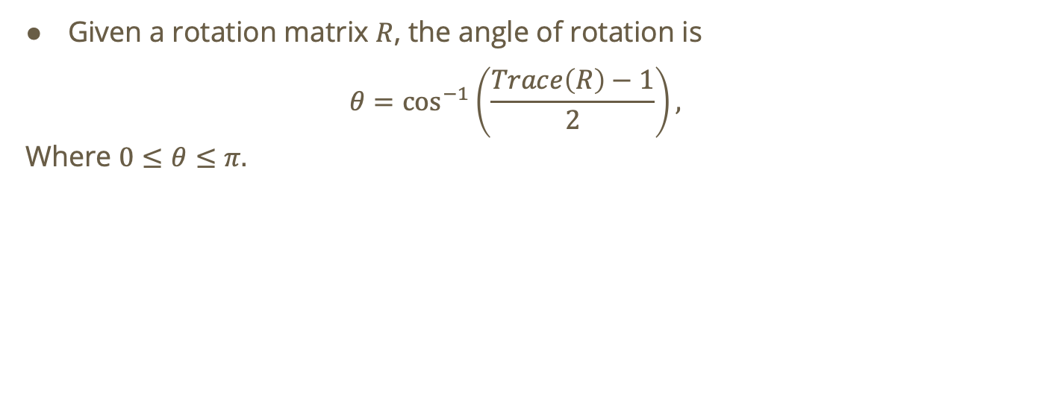
Angle of Rotation about the Fixed Axis
Given a rotation matrix $R$, the angle of rotation is
$$θ=\cos^{−1}\left(\frac{Trace\left(R\right)−1}{2}\right),$$
Where $0≤θ≤π.$

Slide 6
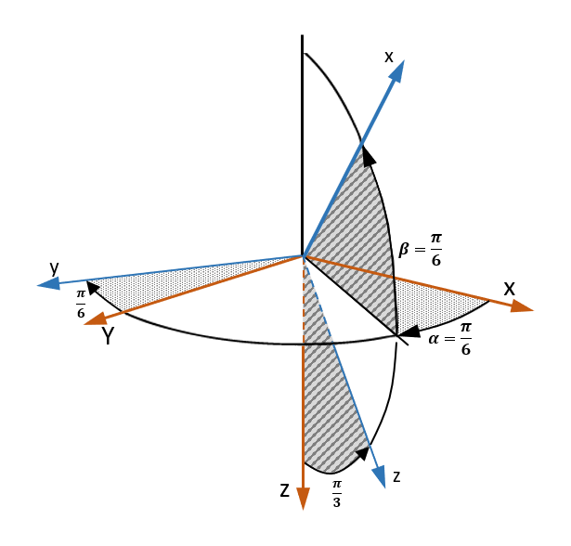
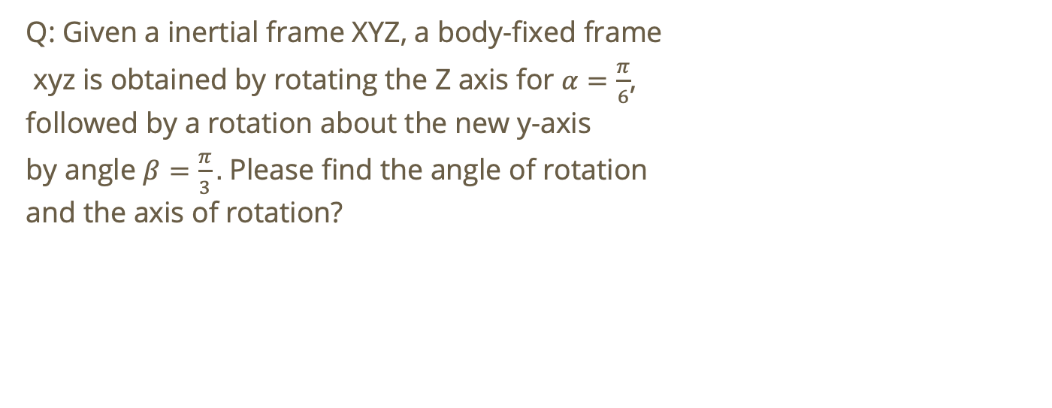
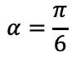
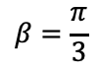
Example
Q: Given a inertial frame XYZ, a body-fixed frame
xyz is obtained by rotating the Z axis for $α=\frac{π}{6}$,
followed by a rotation about the new y-axis
by angle $β=\frac{π}{3}.$ Please find the angle of rotation
and the axis of rotation?
$$β=\frac{π}{3}$$
$$α=\frac{π}{6}$$

Slide 7
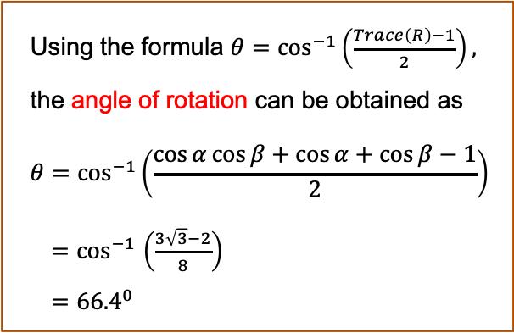
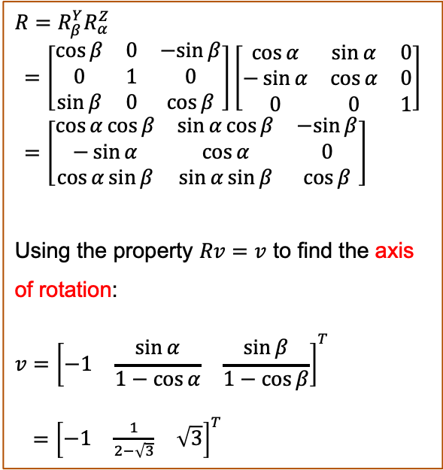
Example - Solution
$$R=R_{β}^{Y}R_{α}^{Z}$$
$$=\left[\begin{matrix}\cos{β} & 0 & −sin{β} \\ 0 & 1 & 0 \\ \sin{β} & 0 & \cos{β}\end{matrix}\right]\left[\begin{matrix}\cos{α} & \sin{α} & 0 \\ −\sin{α} & \cos{α} & 0 \\ 0 & 0 & 1\end{matrix}\right]=\left[\begin{matrix}\cos{α}cos{β} & \sin{α}cos{β} & −sin{β} \\ −\sin{α} & \cos{α} & 0 \\ \cos{α}\sin{β} & \sin{α}sin{β} & \cos{β}\end{matrix}\right]$$
Using the property $Rv=v$ to find the axis of rotation:
$$v={\left[\begin{matrix}−1 & \frac{\sin{α}}{1−\cos{α}} & \frac{\sin{β}}{1−\cos{β}}\end{matrix}\right]}^{T}$$
${=\left[\begin{matrix}−1 & \frac{1}{2−\sqrt{3}} & \sqrt{3}\end{matrix}\right]}^{T}$
Using the formula $θ=\cos^{−1}\left(\frac{Trace\left(R\right)−1}{2}\right),$
the angle of rotation can be obtained as
$$θ=\cos^{−1}\left(\frac{\cos{α}\cos{β}+\cos{α}+\cos{β}−1}{2}\right)$$
${=cos}^{−1}\left(\frac{3\sqrt{3}−2}{8}\right)$
$={66.4}^{0}$

Slide 8
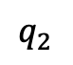
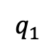
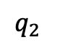
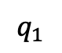
LERP (Linear Interpretation)
Given two quaternion $q_{1}$ and $q_{2}$, their configuration can be shown as
$$q_{2}$$
$$q_{2}$$
$$q_{1}$$
$$q_{1}$$

Slide 9
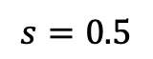
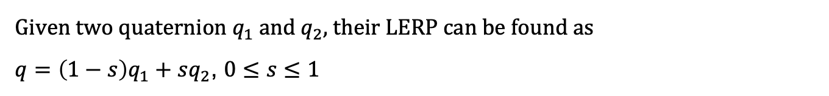
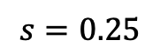
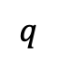
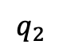
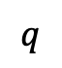
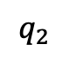
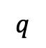
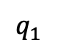
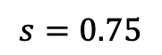
LERP (Linear Interpretation)
Given two quaternion $q_{1}$ and $q_{2}$, their LERP can be found as
$q=\left(1−s\right)q_{1}+sq_{2}$, $0≤s≤1$
$$s=0.25$$
$$s=0.5$$
$$s=0.75$$
$$q_{2}$$
$$q$$
$$q_{2}$$
$$q$$
$$q_{2}$$
$$q$$
$$q_{1}$$
$$q_{1}$$
$$q_{1}$$

Slide 10

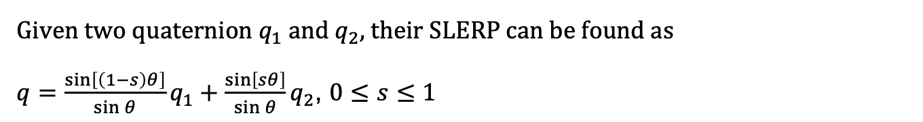
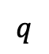
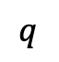

SLERP (Sphere Linear Interpretation)
Given two quaternion $q_{1}$ and $q_{2}$, their SLERP can be found as
$q=\frac{\sin\left[\left(1−s\right)θ\right]}{\sin{θ}}q_{1}+\frac{\sin\left[sθ\right]}{\sin{θ}}q_{2}$, $0≤s≤1$
$$s=0.25$$
$$s=0.5$$
$$s=0.75$$
$$q$$
$$q$$
$$q$$
$$q_{2}$$
$$q_{2}$$
$$q_{2}$$
$$θ$$
$$sθ$$
$$q_{1}$$
$$q_{1}$$
$$q_{1}$$

Slide 11
Comparison
The comparison show the SKERP method demonstrate more uniform interpretation!
Check more detailed comparison at: https://tiborstanko.sk/lerp-vs-slerp.html
$$s=0.25$$
$$s=0.5$$
$$s=0.75$$
$$q_{2}$$
$$q_{2}$$
$$q_{2}$$
$$q_{2}$$
$$q_{2}$$
$$q_{2}$$
$$q_{1}$$
$$q_{1}$$
$$q_{1}$$
$$q_{1}$$
$$q_{1}$$
$$q_{1}$$

Slide 12
Outlines
Rotation Matrix and Quaternion (continued)
Hardware system of UAVs
Preliminaries
Dynamics
PD controller for UAVs

Slide 13
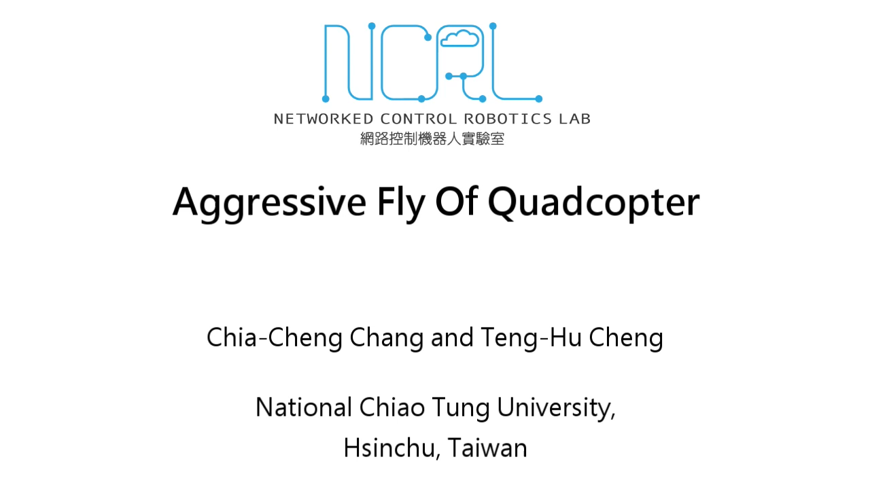
Aggressive Flight of UAVs

Slide 14
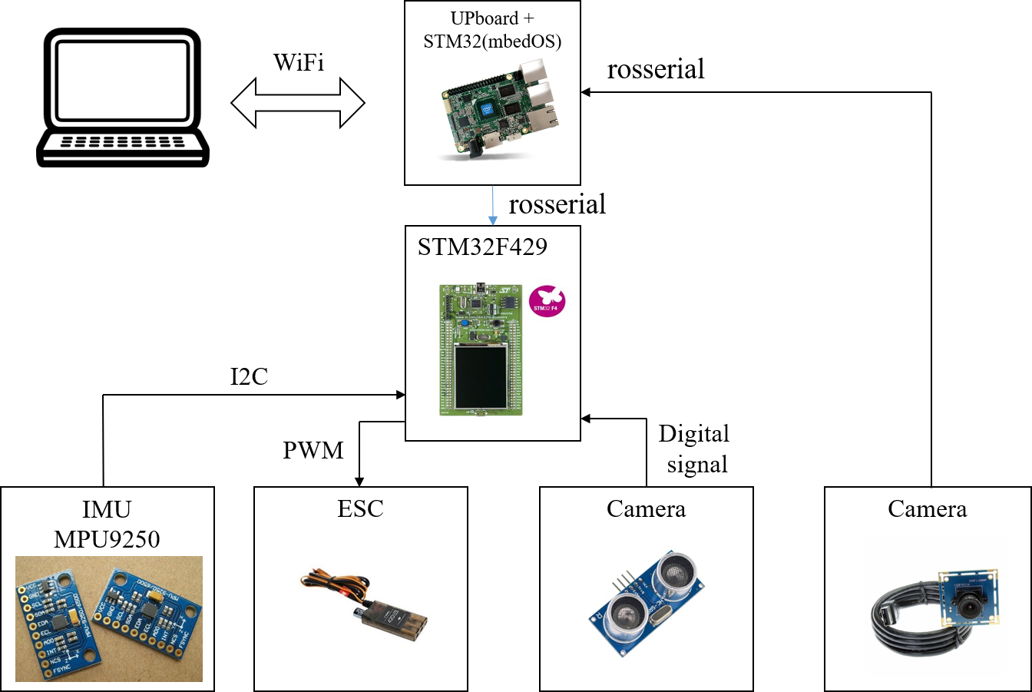
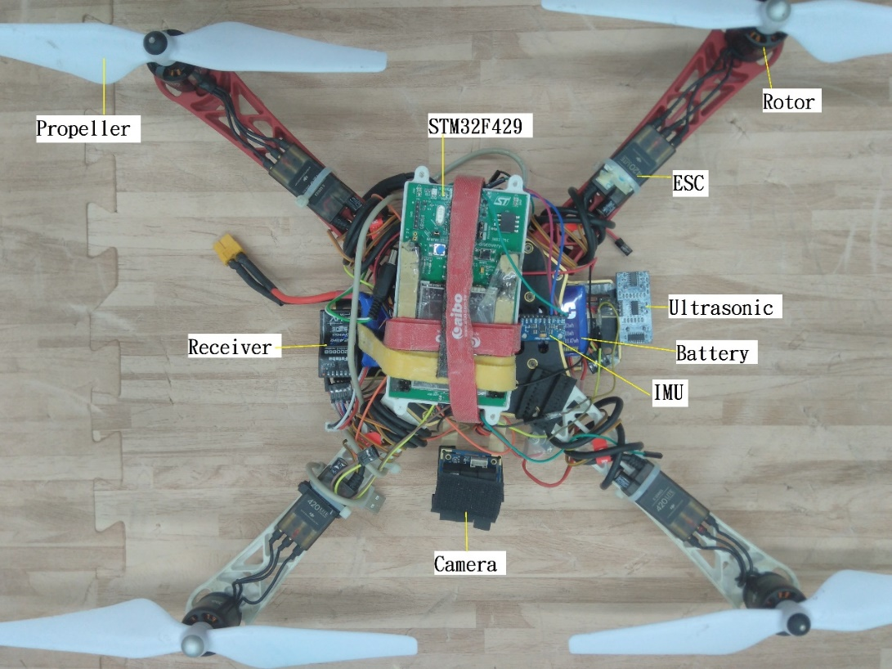
Hardware System of UAVs

Slide 15
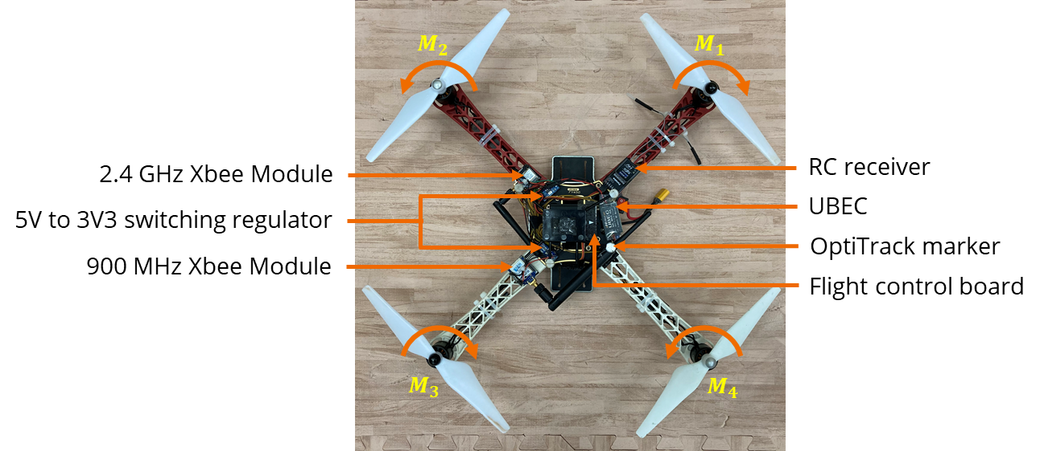
Hardware System of UAVs

Slide 16
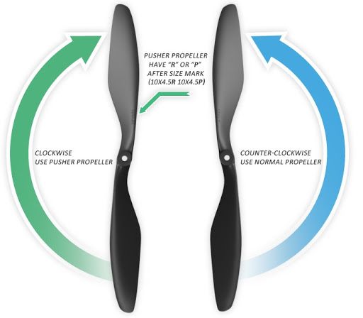
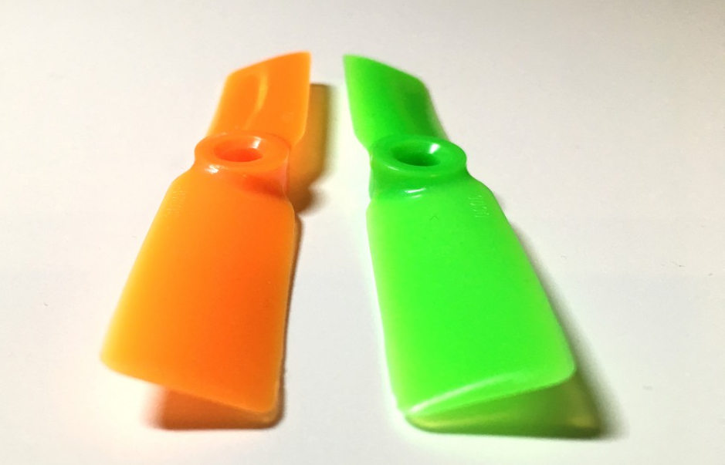
Rotating Directions of Multirotors
Pusher propeler (or P-type), rotating in C.W.
Normal propeler (tractor), rotating in C.C.W.

Slide 17
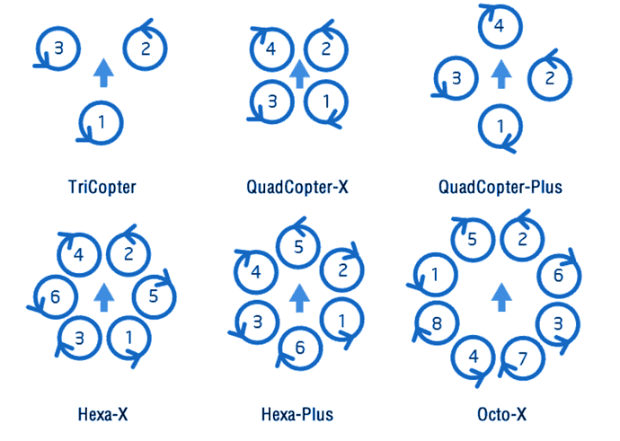
Rotating Directions of Multirotors

Slide 18
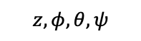
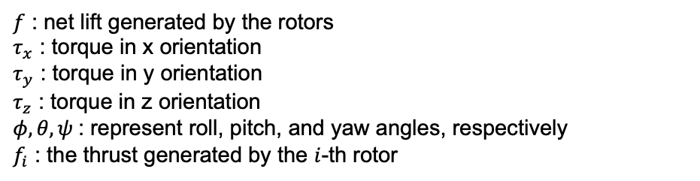
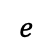
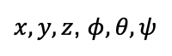
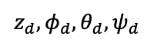
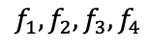
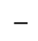
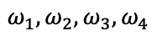
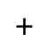
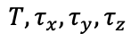
Block Diagram (Closed-Loop System)
$f$ : net lift generated by the rotors
$τ_{x}$ : torque in x orientation
$τ_{y}$ : torque in y orientation
$τ_{z}$ : torque in z orientation
$φ,θ,ψ$: represent roll, pitch, and yaw angles, respectively
$f_{i}$ : the thrust generated by the $i$-th rotor
$$T, τ_{x},τ_{y},τ_{z}$$
$$f_{1}, f_{2},f_{3},f_{4}$$
$$ω_{1}, ω_{2},ω_{3},ω_{4}$$
$$z_{d},φ_{d},θ_{d},ψ_{d}$$
Allocation matrix
Thrust to rotor speed
$$e$$
controller
UAV
(1), (2)
$$+$$
$$−$$
$$z,φ,θ,ψ$$
Sensors:
IMU, GPS, etc.
$x,y,z$, $φ,θ,ψ$

Slide 19
Outlines
Rotation Matrix and Quaternion (continued)
Hardware system of UAVs
Preliminaries
Dynamics
PD controller for UAVs

Slide 20

Eigenvalues and Eigenvectors of A Matrix
Eigenvalue $λ$ and eigenvector $v$ of a matrix $A$ satisfy
$$Av=λv$$

Slide 21
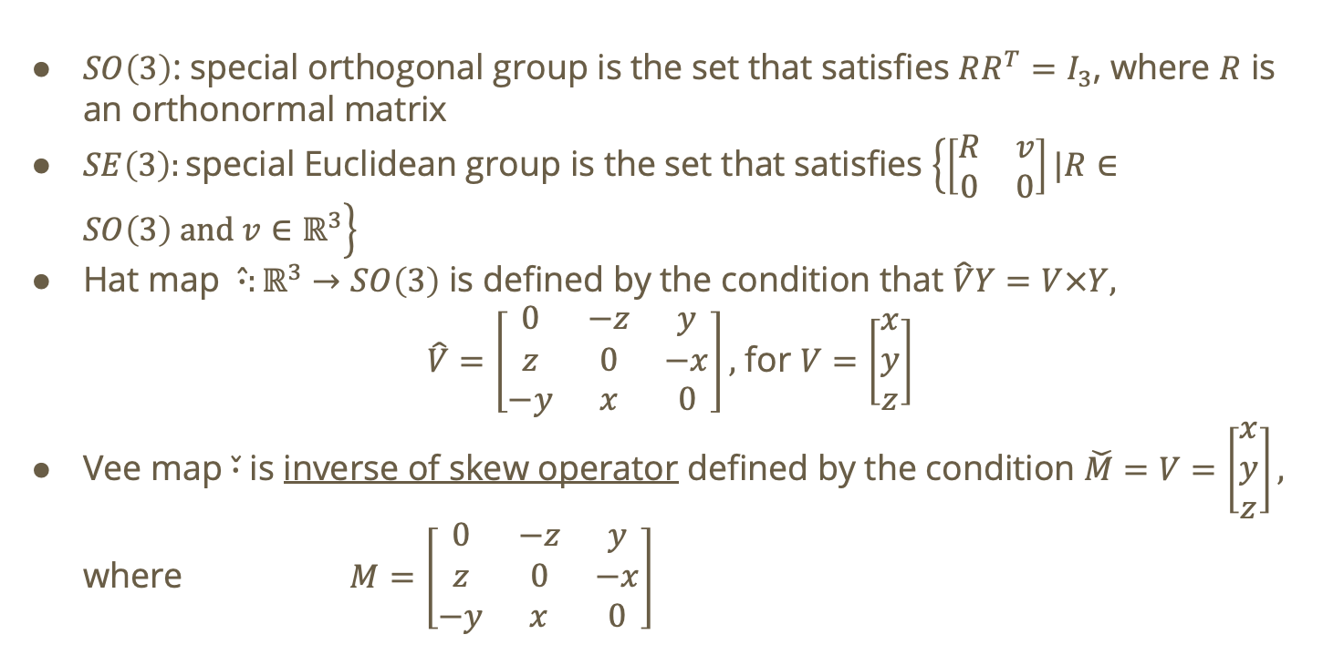
Definitions and Properties
$SO\left(3\right)$: special orthogonal group is the set that satisfies $RR^{T}=I_{3}$, where $R$ is an orthonormal matrix
$SE\left(3\right):\text{special} \text{Euclidean} \text{group}$ is the set that satisfies $\left\{\left[\begin{matrix}R & v \\ 0 & 0\end{matrix}\right]|R∈SO\left(3\right) and v∈ℝ^{3}\right\}$
Hat map $\hat{∙}:ℝ^{3}→SO\left(3\right)$ is defined by the condition that $\hat{V}Y=V×Y,$
$\hat{V}=\left[\begin{matrix}0 & −z & y \\ z & 0 & −x \\ −y & x & 0\end{matrix}\right],$ for $V=\left[\begin{matrix}x \\ y \\ z\end{matrix}\right]$
Vee map $\check{∙}$ is inverse of skew operator defined by the condition $\check{M}=V=\left[\begin{matrix}x \\ y \\ z\end{matrix}\right],$ where $M=\left[\begin{matrix}0 & −z & y \\ z & 0 & −x \\ −y & x & 0\end{matrix}\right]$

Slide 22
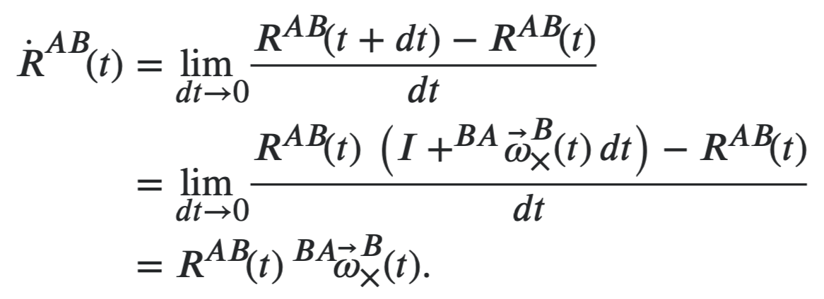
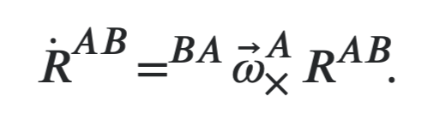

Definitions and Properties
${}_{B}^{I}{\dot{R}}={}_{B}^{I}R{\hat{ω}}_{B}$
${}_{B}^{I}{\dot{R}}={\hat{ω}}_{I}{}_{B}^{I}R$

Slide 23

Definitions and Properties – Example 1
Hat map $\hat{∙}:ℝ^{3}→SO\left(3\right)$ is defined by the condition that $\hat{V}Y=V×Y$
$$\hat{V}=\left[\begin{matrix}0 & −z & y \\ z & 0 & −x \\ −y & x & 0\end{matrix}\right]$$

Slide 24

Definitions and Properties – Example 2
Vee map $\check{∙}:SO\left(3\right)→ℝ^{3}$ is defined by the condition $\check{M}=V=\left[\begin{matrix}x \\ y \\ z\end{matrix}\right],$ where
$$M=\left[\begin{matrix}0 & −z & y \\ z & 0 & −x \\ −y & x & 0\end{matrix}\right]$$

Slide 25














Definitions of Coordinates
$$τ_{2}$$
$$τ_{3}$$
yaw
Heading direction
$$ω_{2}$$
$$ω_{3}$$
$$Z_{B}$$
roll
$$X_{B}$$
$$X_{B}$$
Pitch
$$Y_{B}$$
$$ω_{4}$$
$$ω_{1}$$
$$τ_{1}$$
$$Y_{B}$$
$$τ_{4}$$

Slide 26
Attitudes during Flight
Start
Stop
Acc.
Speed
time
time

Slide 27









Coordinate Transformation
$R_{X}\left(ϕ\right)= \left[\begin{matrix}1 & 0 & 0 \\ 0 & cosφ & sinφ \\ 0 & −sinφ & cosφ\end{matrix}\right]$, $φ$：roll
$R_{Y}\left(θ\right)= \left[\begin{matrix}cosθ & 0 & −sinθ \\ 0 & 1 & 0 \\ sinθ & 0 & cosθ\end{matrix}\right]$, $θ$：pitch
$R_{Z}\left(\text{Ψ}\right)\text{= }\left[\begin{matrix}cosψ & sinψ & 0 \\ −sinψ & cosψ & 0 \\ 0 & 0 & 1\end{matrix}\right]$, $ψ$：yaw
${}_{B}^{I}R=R_{X}\left(φ\right)R_{Y}\left(θ\right)R_{Z}\left(ψ\right)$
$\left[\begin{matrix}X_{I} \\ Y_{I} \\ Z_{I}\end{matrix}\right]={}_{B}^{I}R\left[\begin{matrix}X_{B} \\ Y_{B} \\ Z_{B}\end{matrix}\right]$
$\left[\begin{matrix}\begin{matrix}X_{I} \\ Y_{I}\end{matrix} \\ \begin{matrix}Z_{I} \\ 1\end{matrix}\end{matrix}\right]={}_{B}^{I}{q^{−1}}\left[\begin{matrix}\begin{matrix}X_{B} \\ Y_{B}\end{matrix} \\ \begin{matrix}Z_{B} \\ 1\end{matrix}\end{matrix}\right]$ ${}_{B}^{I}q$
$$Z_{B}$$
$$X_{B}$$
$$Y_{B}$$
$$Z_{I}$$
$$Y_{I}$$
${}_{B}^{I}R$ (or ${}_{B}^{I}q$)
$$X_{I}$$
Inertial frame

Slide 28
Outlines
Rotation Matrix and Quaternion (continued)
Hardware system of UAVs
Preliminaries
Dynamics
PD controller for UAVs

Slide 29








Dynamics
$$T, τ_{x},τ_{y},τ_{z}$$
Dynamics
(Translation + Rotation)
$$f_{1}, f_{2},f_{3},f_{4}$$
$$ω_{1}, ω_{2},ω_{3},ω_{4}$$
$$z_{d},φ_{d},θ_{d},ψ_{d}$$
Allocation matrix
Thrust to rotor speed
$$e$$
controller
UAV
(1), (2)
$$+$$
$$−$$
$$z,φ,θ,ψ$$
Sensors:
IMU, GPS, etc.
$x,y,z$, $φ,θ,ψ$

Slide 30
Attitudes during Flight
Start
Stop
3D Rotation + 3D translation

Slide 31










Free Body Diagram - Force
$$f_{3}$$
$$f_{2}$$
$$f_{4}$$
$$\sum{F}=\left[\begin{matrix}0 \\ 0 \\ −mg\end{matrix}\right]+{}_{B}^{I}R\left[\begin{matrix}0 \\ 0 \\ f\end{matrix}\right]$$
$$Z_{B}$$
(Described in the inertial frame)
inertial frame
body frame
$$f_{1}$$
$$f=f_{1}+f_{2}+f_{3}+f_{4}$$
$$X_{B}$$
$$Y_{B}$$
$$mg$$
31

Slide 32



















Free Body Diagram - Torque
$$Z_{B}$$
$$τ_{3}$$
$$τ_{2}$$
$$τ_{4}$$
$$\sum{M}=\left[\begin{matrix}τ_{x} \\ τ_{y} \\ τ_{z}\end{matrix}\right]$$
$$τ_{1}$$
(Described in the body frame)
$$X_{B}$$
$$Y_{B}$$
$$L_{2}$$
$$L_{2}$$
$τ_{x}:$ $L_{1}f_{1}−L_{1}f_{2}−L_{1}f_{3}+L_{1}f_{4}$
$τ_{y}:$ -$L_{2}f_{1}−L_{2}f_{2}+L_{2}f_{3}+L_{2}f_{4}$
$$τ_{z}=\left(τ_{1}−τ_{2}+τ_{3}−τ_{4}\right)$$
$$ω_{2}$$
$$ω_{3}$$
$$L_{1}$$
$$X_{B}$$
$$ω_{4}$$
$$L_{1}$$
$$ω_{1}$$
$$Y_{B}$$
32

Slide 33







Allocation Matrix
$$τ_{z}$$
$$\left[\begin{matrix}f \\ \begin{matrix}τ_{x} \\ τ_{y}\end{matrix} \\ τ_{z}\end{matrix}\right]=\left[\begin{matrix}\begin{matrix}1 & 1 \\ L_{1} & −L_{1}\end{matrix} & \begin{matrix}1 & 1 \\ −L_{1} & L_{1}\end{matrix} \\ \begin{matrix}−L_{2} & −L_{2} \\ C_{τf} & {−C}_{τf}\end{matrix} & \begin{matrix}L_{2} & L_{2} \\ C_{τf} & −C_{τf}\end{matrix}\end{matrix}\right]\left[\begin{matrix}\begin{matrix}f_{1} \\ f_{2}\end{matrix} \\ \begin{matrix}f_{3} \\ f_{4}\end{matrix}\end{matrix}\right]$$
$$τ_{x}$$
$$τ_{y}$$
$$L_{2}$$
Drag constant
$$L_{1}$$
Control
Inputs
Motor thrusts

Slide 34













Free Body Diagram
$$f_{3}$$
$$f_{2}$$
$$f_{4}$$
$$Z_{B}$$
$$τ_{3}$$
$$\sum{F}=\left[\begin{matrix}0 \\ 0 \\ −mg\end{matrix}\right]+{}_{B}^{I}R\left[\begin{matrix}0 \\ 0 \\ f\end{matrix}\right]$$
$$\sum{M}=\left[\begin{matrix}τ_{x} \\ τ_{y} \\ τ_{z}\end{matrix}\right]$$
(Described in the inertial frame)
$$τ_{2}$$
$$τ_{4}$$
$$f_{1}$$
inertial frame
body frame
$$τ_{1}$$
$$X_{B}$$
$$Y_{B}$$
(Described in the body frame)
$$Z_{I}$$
$$Y_{I}$$
$$mg$$
$$X_{I}$$
Inertial frame

Slide 35

















Equation of Motion
$$f_{4}$$
$$f_{3}$$
$$τ_{4}$$
$$\sum{F}=m\left[\begin{matrix}\ddot{x} \\ \ddot{y} \\ \ddot{z}\end{matrix}\right]$$
$$\sum{M=J\dot{ω}+ω×Jω}$$
$$\sum{F}={}_{B}^{I}R\left(\left[\begin{matrix}0 \\ 0 \\ f\end{matrix}\right]\right)−\left[\begin{matrix}0 \\ 0 \\ g\end{matrix}\right]$$
$$τ_{3}$$
$$Z_{B}$$
$$f_{2}$$
$$f_{1}$$
$$τ_{2}$$
$$Y_{B}$$
$$τ_{1}$$
$$X_{B}$$
$$Z_{I}$$
$$Y_{I}$$
$$X_{I}$$
Inertial frame

Slide 36



Equation of Motion
rotation matrix from the body frame
To the inertial frame
Translational dynamics:
$\left[\begin{matrix}\ddot{x} \\ \ddot{y} \\ \ddot{z}\end{matrix}\right]=\frac{1}{m}{}_{B}^{I}R\left(\left[\begin{matrix}0 \\ 0 \\ f\end{matrix}\right]\right)−\left[\begin{matrix}0 \\ 0 \\ g\end{matrix}\right]$. (1)
mass of the UAV
net thrust
gravity
$${}_{B}^{I}{\dot{R}}={}_{B}^{I}R\hat{ω}$$
$\dot{ω}=J^{−1}\left(\left[\begin{matrix}τ_{x} \\ τ_{y} \\ τ_{z}\end{matrix}\right]−ω×Jω\right)$ . (2)
Rotational dynamics:
Moment of inertia of the UAV
torque produced by propellers
Gyroscopic effects

Slide 37


Equation of Motion – with disturbances
rotation matrix from the body frame
To the inertial frame
aerodynamic effects
external forces
Translational dynamics:
$$\left[\begin{matrix}\ddot{x} \\ \ddot{y} \\ \ddot{z}\end{matrix}\right]=\frac{1}{m}R_{IB}\left(\left[\begin{matrix}0 \\ 0 \\ f\end{matrix}\right]+F_{aero}\right)−\left[\begin{matrix}0 \\ 0 \\ g\end{matrix}\right]+\frac{1}{m}F_{ext}$$
mass of the UAV
net thrust
gravity
Control Inputs
$${}_{B}^{I}{\dot{R}}={}_{B}^{I}R\hat{ω}$$
$$\dot{ω}=J^{−1}\left(\left[\begin{matrix}τ_{x} \\ τ_{y} \\ τ_{z}\end{matrix}\right]+\left[\begin{matrix}0 \\ 0 \\ τ_{ext}\end{matrix}\right]−ω×Jω+τ_{rotors}\right)$$
Rotational dynamics:
Moment of inertia of the UAV
torque produced by propellers
External torque
Gyroscopic effects
Propeller gyroscopic effects

Slide 38


Transformation from Force/Torque to Rotor Speed
$$T, τ_{x},τ_{y},τ_{z}$$
$$f_{1}, f_{2},f_{3},f_{4}$$
$$ω_{1}, ω_{2},ω_{3},ω_{4}$$
$$z_{d},φ_{d},θ_{d},ψ_{d}$$
Transformation from Force/Torque to Rotor Speed
Allocation matrix
Thrust to rotor speed
$$e$$
controller
UAV
(1), (2)
$$+$$
$$−$$
$$z,φ,θ,ψ$$
Sensors:
IMU, GPS, etc.
$x,y,z$, $φ,θ,ψ$

Slide 39



Transformation from Force/Torque to Rotor Speed
$$\left[\begin{matrix}f \\ \begin{matrix}τ_{x} \\ τ_{y}\end{matrix} \\ τ_{z}\end{matrix}\right]=\underset{\begin{aligned} \\ M_{AL}\end{aligned}}{\underbrace{\left[\begin{matrix}\begin{matrix}1 & 1 \\ L_{1} & −L_{1}\end{matrix} & \begin{matrix}1 & 1 \\ −L_{1} & L_{1}\end{matrix} \\ \begin{matrix}−L_{2} & −L_{2} \\ C_{τf} & {−C}_{τf}\end{matrix} & \begin{matrix}L_{2} & L_{2} \\ C_{τf} & −C_{τf}\end{matrix}\end{matrix}\right]}}\left[\begin{matrix}\begin{matrix}f_{1} \\ f_{2}\end{matrix} \\ \begin{matrix}f_{3} \\ f_{4}\end{matrix}\end{matrix}\right]$$
$$f_{i}=k_{f}ω_{i}^{2}$$
$$\left[\begin{matrix}f \\ \begin{matrix}τ_{x} \\ τ_{y}\end{matrix} \\ τ_{z}\end{matrix}\right]=\underset{\begin{aligned} \\ M_{AL}\end{aligned}}{\underbrace{\left[\begin{matrix}\begin{matrix}1 & 1 \\ L_{1} & −L_{1}\end{matrix} & \begin{matrix}1 & 1 \\ −L_{1} & L_{1}\end{matrix} \\ \begin{matrix}−L_{2} & −L_{2} \\ C_{τf} & {−C}_{τf}\end{matrix} & \begin{matrix}L_{2} & L_{2} \\ C_{τf} & −C_{τf}\end{matrix}\end{matrix}\right]}}\left[\begin{matrix}\begin{matrix}k_{f}ω_{i}^{2} \\ k_{f}ω_{i}^{2}\end{matrix} \\ \begin{matrix}k_{f}ω_{i}^{2} \\ k_{f}ω_{i}^{2}\end{matrix}\end{matrix}\right]$$

Slide 40
Outlines
Rotation Matrix and Quaternion (continued)
Hardware system of UAVs
Preliminaries
Dynamics
PD controller for UAVs

Slide 41










PID Feedback Controller
Controller
P
controller
$$+$$
$$x_{d}$$
$$e$$
I
controller
$$+$$
Plant
$$y$$
$$+$$
$$−$$
$$+$$
D
controller
$$x$$
Measurement

Slide 42













PD Controller Design
$$τ_{x}$$
$$τ_{y}$$
$$τ_{z}$$
$$T, τ_{x},τ_{y},τ_{z}$$
$$f_{1}, f_{2},f_{3},f_{4}$$
$$ω_{1}, ω_{2},ω_{3},ω_{4}$$
PD
Controller
$$z_{d},φ_{d},θ_{d},ψ_{d}$$
Allocation matrix
Thrust to rotor speed
$$e$$
PD
controller
UAV
(1), (2)
$$+$$
$$−$$
$$z,φ,θ,ψ$$
Sensors:
IMU, GPS, etc.
$x,y,z$, $φ,θ,ψ$

Slide 43




Tracking Errors for the Multirotors
Tracking error in Z direction: $z_{d}−z$
………………..in $φ$ direction: $φ_{d}−φ$
………………..in $θ$ direction: $θ_{d}−θ$
………………..in $ψ$ direction: $ψ_{d}−ψ$,
where the angles can be obtained from the following relations:
$$R=R_{Z}\left(ψ\right)R_{Y}\left(θ\right)R_{X}\left(φ\right)=$$
cos$φ$
$φ=\tan^{−1}\left(\frac{R_{32}}{R_{33}}\right)$, $θ=−\sin^{−1}\left(R_{31}\right), ψ=\tan^{−1}\left(\frac{R_{21}}{R_{11}}\right)$
For special cases, please check ref.:
http://www.close-range.com/docs/Computing_Euler_angles_from_a_rotation_matrix.pdf

Slide 44
Transformation from Force/Torque to Rotor Speed
$$T, τ_{x},τ_{y},τ_{z}$$
$$f_{1}, f_{2},f_{3},f_{4}$$
$$ω_{1}, ω_{2},ω_{3},ω_{4}$$
$$z_{d},φ_{d},θ_{d},ψ_{d}$$
Transformation from Force/Torque to Rotor Speed
Allocation matrix
Thrust to rotor speed
$$e$$
controller
UAV
(1), (2)
$$+$$
$$−$$
$$z,φ,θ,ψ$$
Sensors:
IMU, GPS, etc.
$x,y,z$, $φ,θ,ψ$

Slide 45






PID Controller for the Multirotors
$$\left[\begin{matrix}f \\ \begin{matrix}τ_{x} \\ τ_{y}\end{matrix} \\ τ_{z}\end{matrix}\right]=\underset{\begin{aligned} \\ M_{AL}\end{aligned}}{\underbrace{\left[\begin{matrix}\begin{matrix}1 & 1 \\ L_{1} & −L_{1}\end{matrix} & \begin{matrix}1 & 1 \\ −L_{1} & L_{1}\end{matrix} \\ \begin{matrix}−L_{2} & −L_{2} \\ C_{τf} & {−C}_{τf}\end{matrix} & \begin{matrix}L_{2} & L_{2} \\ C_{τf} & −C_{τf}\end{matrix}\end{matrix}\right]}}\left[\begin{matrix}\begin{matrix}f_{1} \\ f_{2}\end{matrix} \\ \begin{matrix}f_{3} \\ f_{4}\end{matrix}\end{matrix}\right]$$
$$\left[\begin{matrix}f_{1} \\ \begin{matrix}f_{2} \\ f_{3}\end{matrix} \\ f_{4}\end{matrix}\right]={M_{AL}}^{−1}\left[\begin{matrix}\begin{matrix}τ_{x} \\ τ_{y}\end{matrix} \\ \begin{matrix}τ_{z} \\ f\end{matrix}\end{matrix}\right]$$
Computed from the controller
$$f_{i}=k_{f}ω_{i}^{2}$$
$$\left[\begin{matrix}\begin{matrix}ω_{1}^{2} \\ ω_{2}^{2}\end{matrix} \\ \begin{matrix}ω_{3}^{2} \\ ω_{4}^{2}\end{matrix}\end{matrix}\right]=\frac{1}{k_{f}}\left[\begin{matrix}f_{1} \\ \begin{matrix}f_{2} \\ f_{3}\end{matrix} \\ f_{4}\end{matrix}\right]=\frac{1}{k_{f}}{M_{AL}}^{−1}\left[\begin{matrix}f \\ \begin{matrix}τ_{x} \\ τ_{y}\end{matrix} \\ τ_{z}\end{matrix}\right]$$
Solve
$$\left[\begin{matrix}\begin{matrix}ω_{1} \\ ω_{2}\end{matrix} \\ \begin{matrix}ω_{3} \\ ω_{4}\end{matrix}\end{matrix}\right]$$
The angular velocity $ω_{i}$ can be controlled by the PWM command from the MCU to the ESC.

Slide 46


Other Ways to Compute the Tracking Errors ?
Find the rotation axis $v$ by the following property:
$${}_{cur}^{des}Rv=v,$$
where ${}_{cur}^{des}R=R_{des}^{T}$ $R_{Cur}$, and $v$ can be the axis of rotation and represents the direction of
$$\left[\begin{matrix}φ−φ_{d} \\ θ−θ_{d} \\ {ψ−ψ}_{d}\end{matrix}\right]$$
The angle of rotation is $\cos^{−1}\left(\frac{Trace\left({}_{cur}^{des}R\right)−1}{2}\right).$
$$θ$$
$${}_{cur}^{des}q$$

Slide 47
Recap - Hardware System of UAVs

